Slide 1

ANALYZING THE IMPACT OF FEATURE SELECTION ON MACHINE LEARNING ALGORITHMS: A MULTI-DATASET INVESTIGATION
Nahush Agrawal
UEA ID: 100396743

Slide 2

Objective
The study examines the impact of feature selection on machine learning model effectiveness. It employs performance metrics to assess model performance and monitors how they alter as a result of feature choices.
In order to enhance the performance of machine learning models, relevant features [Independent variable] from datasets are chosen
Using the Hybrid (Filter-Wrapper) and Wrapper approaches.
both approaches are used here and are applied to different datasets. After feature selection, the performance of models utilizing the chosen features against using all of the features is compared to assess how successful these strategies are.

Slide 3

What is Feature Selection ?

Slide 4

Feature selection is a process in which you automatically or manually select those features (or variables) which contribute most to your prediction variable or output in which you are interested. Having irrelevant features in your data can decrease the accuracy of many models, especially linear algorithms like linear and logistic regression.
Filter Methods: These methods use statistical measures to score each feature. Examples includePearson correlation coefficient scores and chi-squared tests.
Wrapper Methods: These methods consider the selection of a set of features as a search problem. Examples include recursive feature elimination, Sequential Forward Selection and Sequential Backward Selection.
Embedded Methods: These methods learn which features best contribute to the accuracy of the model while the model is being created. Examples include regularization methods like LASSO.

Slide 5

Why Feature Selection?

Slide 6
Improves Model Performance :Models can improve their generalisation and accuracy by deleting unnecessary or superfluous features.
Reduces Overfitting:The likelihood that the model will memorise the training data and struggle to generalise to new data is decreased by using only pertinent characteristics.
Enhances Model Interpretability: In industries like healthcare or finance where interpretability is critical, a model with fewer elements is frequently easier to comprehend and interpret.
Improves Data Quality: By minimising noise and potential inaccuracies in the data, removing unnecessary characteristics can improve data quality.
Eliminates Multicollinearity: By deleting strongly associated characteristics, feature selection may make sure that each item offers new information.

Slide 7

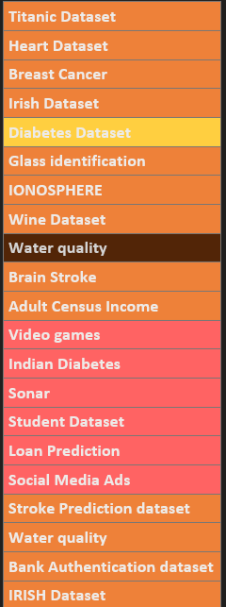
Datasets Overview
Techniques for feature selection were used on datasets as those for the Titanic, Heart, Breast Cancer, and other diseases. Both the wrapper alone and the hybrid (fusing the filter and wrapper approaches) were applied.
These techniques improved model accuracy by fine-tuning features across a range of datasets, including those related to health (such as diabetes and brain stroke) and finance (such as loan prediction and bank authentication). For accurate forecasts and insights across a variety of disciplines, this optimisation is essential.

Slide 8

Feature Selection Techniques

Slide 9

Hybrid (Filter – Wrapper Method )
The advantages of both filter and wrapper technologies are combined in the hybrid filter-wrapper strategy. In the beginning, it uses filter techniques to swiftly pick out aspects that aren't important based on statistical measurements. To carefully choose the optimal feature subsets suited to a particular model's performance, wrapper approaches such as RFE (Recursive Feature Elimination) are then used. By combining computing economy with the accuracy and flexibility of wrappers, this integrated approach optimises feature selection and ensures reliable model performance.
Wrapper(SFS,SBS and RFE)
Techniques for feature selection include wrapper approaches like RFE (Recursive Feature Elimination), SFS (Sequential Forward Selection), and SBS (Sequential Backward Selection). In order to ensure the best feature combinations, they analyse subsets of characteristics by training a model. Based on model performance, SFS adds, SBS eliminates, and RFE recursively picks features.

Slide 10
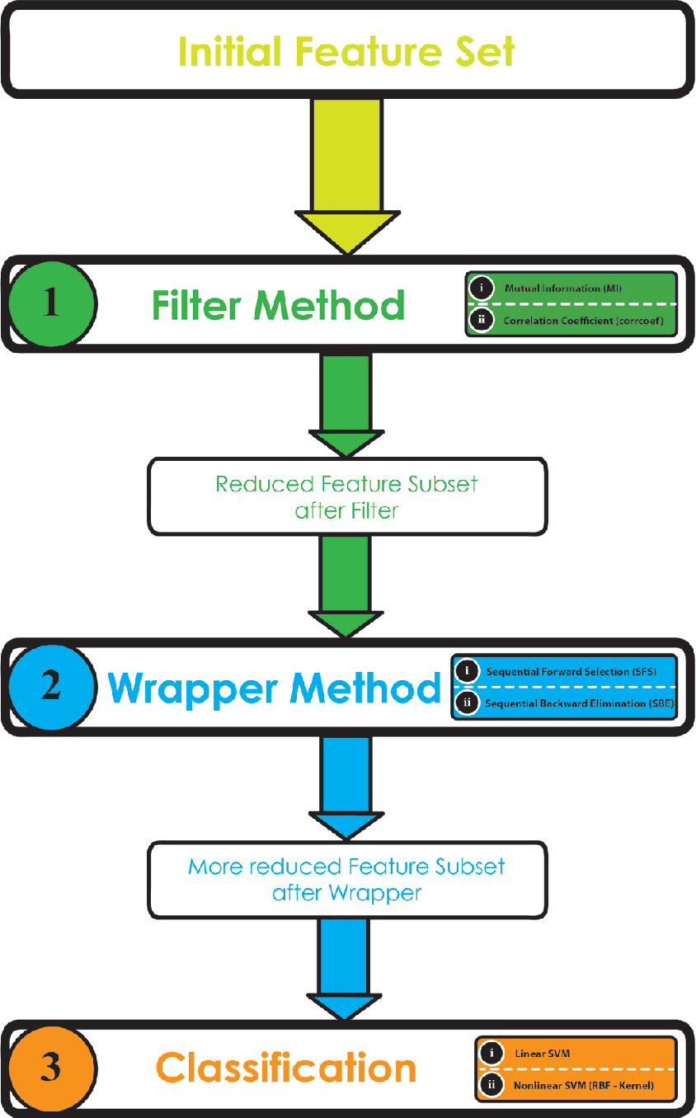
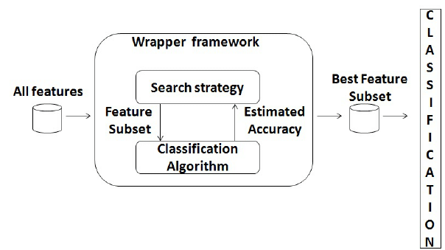
Wrapper (SFS,SBS and RFE)
Hybrid (Filter-Wrapper)

Slide 11

Model Selection

Slide 12
Logistic Regression
Logistic regression is ideal for binary or categorical tasks, providing a simple baseline to assess feature effects in classification. . It is especially suitable when you want to understand the effect of individual features on the outcome. In this study, Logistic Regression helps to assess the baseline performance of models before and after feature selection.
SVM
SVM excels in diverse classification tasks (binary and multi-class) by capturing complex feature-label relationships, especially in high-dimensional spaces, aiding feature selection evaluation
Decision Tree
Decision Trees offer interpretable models for binary/multi-class tasks. Transparency aids understanding of feature importance via feature selection, assessing interpretability and decision boundaries.Also helpful to assest how feature selection affects model interpretability.
Naïve Bayes
Naïve Bayes is valuable for text classification and when feature independence is assumed. While less common in high-dimensional data, it's useful for assessing feature selection's impact on models, especially in text or categorical data where the independence assumption may apply or be violated.
Random Forest
Random Forest is an ensemble method known for its ability to handle high-dimensional datasets and capture non-linear relationships. It can serve as a robust benchmark to evaluate how feature selection techniques impact the performance of a complex model.

Slide 13

Experimental Design

Slide 14
Evaluation Metrics
Evaluation metrics gauge the performance of machine learning models. They include
Accuracy (correct predictions out of total), considering example like glass dataset,Heart Dataset etc.
Precision (true positives over predicted positives),
Recall (true positives over actual positives),
considering example social media ads.
F1 score (harmonic mean of precision and recall). These metrics provide insights into a model's effectiveness,unified , great for imbalance datasets and its potential areas of improvement considering example like wine dataset.
Good for imabalance data and situation like trade off between precision and recall .

Slide 15
Hybrid Filtter Wrapper Based
1. Data Initialization and Preprocessing:
Load , cleaned and encoded dataset post data preprocessing, including categorical feature encoding.
After loading the dataset, split it into training and testing sets as part of data initialization.
2. Hybrid Filter-Wrapper Feature Selection:
- Employ statistical analysis techniques (e.g., Pearson correlation, chi-squared tests, information gain) to measure feature relevance to the target variable.
- Implement methods like univariate analysis.
- Utilize Recursive Feature Elimination (RFE) to systematically rank and reduce features based on importance until the desired subset size is achieved.
3. Performance Assessment:
- After obtaining featuresTrained the machine learning models and perform hyperparameter tuning .
- Evaluate the model's performance using metrics such as precision, F1 score, accuracy, and AUC for the selected feature subset based on test data.
4. Full Feature Set Benchmarking:
- Compare the model's performance using all available features, utilizing the same performance metrics.
5. Iterative Evaluation:
- Repeat the entire process for remaining datasets.
This approach outlines the steps for data preparation, feature selection using a hybrid filter-wrapper method, performance assessment, benchmarking with the full feature set, and iterative evaluation across various algorithms and datasets.

Slide 16
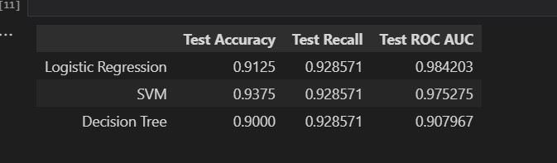
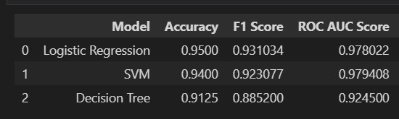
Hybrid Based Example
Social Media Adv Dataset
All Features
Hybrid Based Feature Selection

Slide 17

Wrapper Based {RFE , SFS, SBS}
1. Data Initialization and Preprocessing:
Load , cleaned and encoded dataset post data preprocessing, including categorical feature encoding.
After loading the dataset, split it into training and testing sets as part of data initialization.
2.Wrapper Methods[RFE,SFS,SBS]
For forward selection: Add one feature at a time, eval- uating model performance at each step until reaching an optimal subset. - For backward elimination: Begin with all features and remove one at a time, evaluating model performance at each step until reaching an optimal subset. - For RFE: Rank features and iteratively remove the least important feature until reaching the desired subset size. ¡mention about classifiers used.
3. Performance Assessment:
- Trained the machine learning models
- Evaluate the model's performance using metrics such as precision, F1 score, accuracy, and AUC for the selected feature subset based on test data.
4. Full Feature Set Benchmarking:
- Compare the model's performance using all available features, utilizing the same performance metrics.
5. Iterative Evaluation:
- Repeat the entire process for remaining datasets.
This approach outlines the steps for data preparation, feature selection using a hybrid filter-wrapper method, performance assessment, benchmarking with the full feature set, and iterative evaluation across various algorithms and datasets.

Slide 18
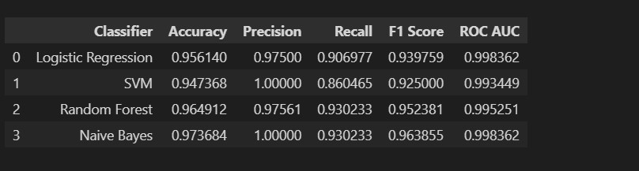
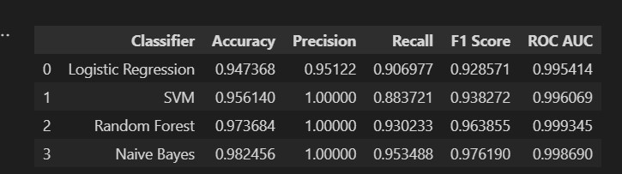
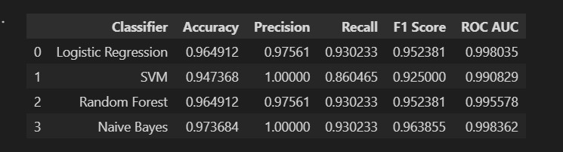
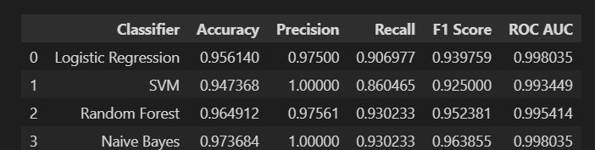
Wrapper based Example
Breast Cancer Dataset
All Features
SFS
RFE
SBS

Slide 19

Performance Highlights

Slide 20
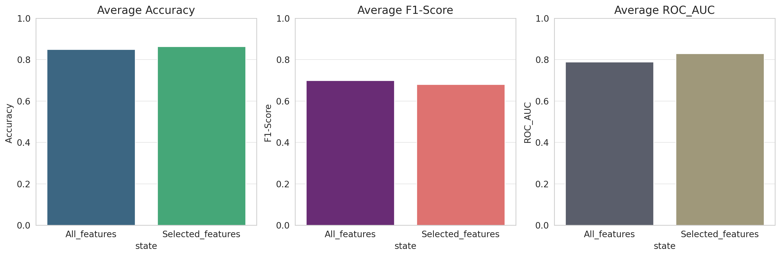
Hybrid Based Results
On datasets with all features and hybrid-selected features, three models (Logistic Regression, SVM, and Decision Tree) were assessed. While Decision Tree preferred hybrid-selected features, Logistic Regression performed consistently across both feature sets. The accuracy of SVM remained constant for both. The hybrid approach was favoured by Logistic and Decision Tree in terms of F1-Score and ROC AUC.
In general based on research, there are only slight distinctions between all-features and hybrid feature selection, with hybrid having an advantages in some cases.

Slide 21
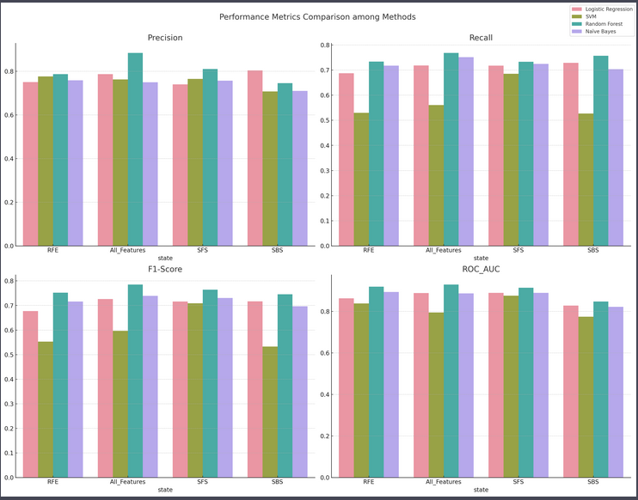
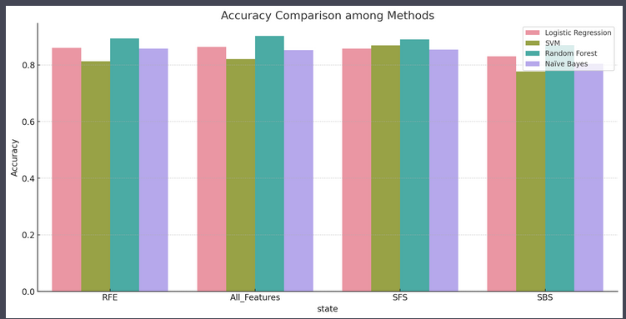
Wrapper Based Results
Performance measures show that Random Forest with RFE is superior than SVM, but only when all features are used. The recall and F1-Score of Random Forest are improved by RFE and SFS approaches. For a model to be accurate, features must be chosen carefully. RFE and the wrapper technique have promise for use across a variety of datasets. Model qualities and dataset complexity affect how successful a model is.
Upon analyzing the aggregate outcomes, it was observed that after implementing feature selection, the model, especially when trained with RFE-selected features, surpassed the performance of models trained on all features for most of the datasets. This underscores the notion that feature selection can indeed enhance model performance.

Slide 22
Encountered Issues
Class Bias
The algorithm, like decision trees and random forests, addresses this. Decision trees segregate data using features, possibly highlighting minority classes. Random Forests employ several trees and bootstrap sampling, promoting a balanced class portrayal and reducing bias.
Overfitting
Feature selection reduces overfitting by eliminating irrelevant or noisy features, simplifying the model. Cross-validation assesses model performance on various data subsets, ensuring robustness and preventing tuning to specific data quirks. Together, they enhance model generalization, reducing the risk of overfitting on unseen data.
Computation time
Feature selection reduces the number of features, leading to simpler models. With fewer data dimensions, algorithms require less computation, thereby decreasing training and prediction times.
Collinearity
Hybrid feature selection first uses Pearson correlation (filter) to identify and remove highly correlated features. Then, RFE (wrapper) optimally selects features without reintroducing collinearity, ensuring a robust and collinearity-free feature subset for modeling.
Handling High Dimensional data
For high-dimensional data, hybrid feature selection first uses filters to quickly reduce dimensionality. This makes subsequent wrapper methods more computationally efficient and accurate than using wrappers alone.

Slide 23

Hybrid Based & Wrapper: Advantage and Disadvantages

Slide 24

Hybrid Based Filter-Wrapper
Advantages
Reduced Dimensionality with Accuracy
Mitigates Overfitting:
Optimal Balance (Combines positives of both):
Disadvantages
Increased Complexity(Inter method conflict):
Computational Overhead in case of larger datasets.
Possibility of crucial feature deletion

Slide 25

Wrapper (SFS,SBS and RFE)
Advantages
Optimal Subsets,
Better handling multicollinearity,
Disadvantages
Exhaustive Search can Be Time :
Computationally Expensive:
Risk of Overfitting due to lack of validation:

Slide 26
Interesting Findings
Adding more features doesn’t improve model performance.
Some features become relevant when combined with others.
For better feature selection domain knowledge is very important.
In some scenarios there is non linear relationship between dependent and independent variables generally tree models or kernel model can be helpful .

Slide 27
Recommendations
Domain Knowledge
Avoid overfitting
Use Cross Validation
Stability is Important

Slide 28

Concluding Thoughts
The hybrid filter-wrapper technique combines computational efficiency with comprehensive feature selection, making it suitable for datasets with numerous features.
Two-Phase Selection: This strategy greatly shrinks the feature space by starting with a filter method, making the subsequent wrapper phase easier and perhaps lowering overfitting, especially with sparse data.
Combination of Strengths: The hybrid approach ensures a robust feature selection procedure that takes into consideration characteristics important in isolation and in combination by combining the global perspective of filter methods with the precision of wrapper techniques.
Wrapper's Tailored Approach :The wrapper technique, which excels at capturing complex feature interactions but has a greater computational cost, enables a bespoke feature selection procedure that is tailored particularly for a certain machine learning model.
Balanced versus Precision: Despite the fact that the hybrid technique strikes a compromise between extensive feature selection and computing efficiency, depending on the research goals, certain models and datasets may respond better to the wrapper method.

